Slide 1
JEPPIAAR INSTITUTE OF TECHNOLOGY “Self-Belief | Self Discipline | Self Respect” Department of Computer Science and Engineering SUBJECT NAME : DATABASE AND MANAGEMENT SYSTEM PRESENTATION TITLE: TERADATA TEAM MEMBERS:
 | STUDENTS NAME 1. BALAJI R | REG.NO: 210618104007
 | 2.PARVEEN KUMAR K K | 210618104035
 | 3.PRANESH | 210618104034
 | 4.CHANDRU | 210618104010
 | 5 HARIKRISHNAN | 210618104018
 | 6. GOKUL | 210618104016

Slide 2
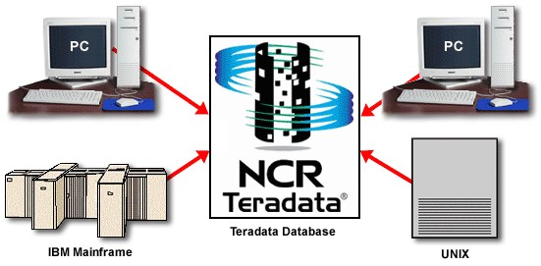
TERADATA IN THE ENTERPRISE
Teradata is relational database management system
Acts as central enterprise-wide database
Contains information extracted from operational systems
Central placement minimizes data duplication and provides single view of business

Slide 3
TERADATA SCALES LINEARLY
Scaling achieved via ‘shared nothing’ architecture and unconditional para
Power is in linear scalability, where slope = 1
Scales with data
Scales with users
Scales with work
More nodes More work More users More data
Node Work Users Data

Slide 4
THE TERADATA DIFFERENCE
Data Volume
“MULTI-DIMENSIONAL SCALABILITY”
(Raw, User Data)
Mixed Query
Workload Concurrency
Data Freshness
Query Complexity
Query Freedom
Schema Sophistication
Query Data Volume

Slide 5
KEY TERADATA DIFFERENTIATORS
Parallelism throughout platform
Shared Nothing Architecture
Proprietary intelligent system inter-connect

Slide 6
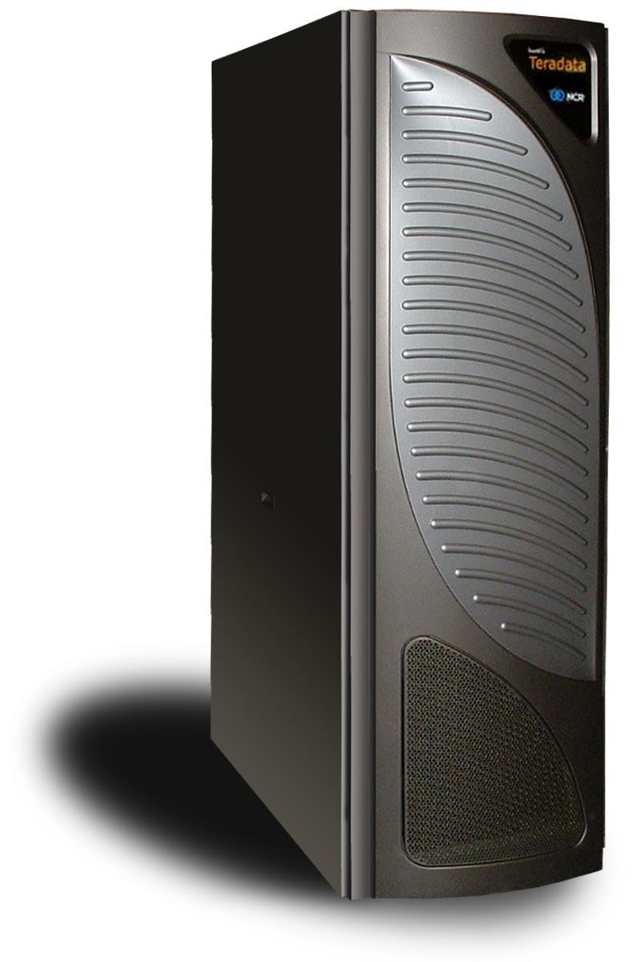
NCR 5400 SERVER VALUE PROP
Better Price/Performance
20% Performance Improvement
12% Price/Performance Improvement
Advanced Cabinet Design
Up to 10 Nodes Per Cabinet
Up to a 40% Reduction in Floor Space
Investment Protection
Multi Generation (5) Coexistence
32-bit/64-bit Transition Platform

Slide 7
NCR 5400 SERVER KEY MESSAGES
#2 – ADVANCED CABINET DESIGN
Revolutionary cabinet increases reliability and provides greater configuration flexibility.
Ethernet Switches
BYNET V3 Switches
FC Switches
1
3
up to 10 nodes per cabinet enable a 20% - 40% smaller footprint than the 5380
30% increase in system storage reliability with new advanced cooling mechanisms
Extend supported distance for large systems (65+ nodes) between cabinets to 300 – 600 meters with new BYNET V3.
Doubles the number of configurable
1
3
1
3
1
Up to 10 nodes within each cabinet
3
1
3
1
3
1
3
1
3
1
3
Server Management Module (3GSM)
1
3
1
3
Five UPS
Modules
nodes to 1,024

Slide 8
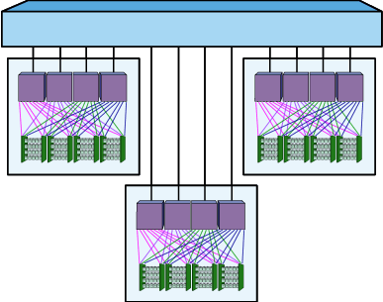
MPP SYSTEM CONFIGURATION
Nodes grouped to increase data availability and system uptime
Not shared storage but access within group
Improves data availability
Improves system up time
Allows for VPROC migration

Slide 9
TERADATA OPTIMIZER
The Teradata Optimizer is the most robust in the industry
Optimizer is parallel-aware, understands available system components
Handles mixed work loads
Multiple complex queries
Joins per query
Unlimited ad-hoc processing
Output is least expensive plan (resources) to answer request

Slide 10
DATA PROTECTION (OBJECT LOCKS)
Locks protect data from simultaneous access
Vary by type
Exclusive,Write, Read, & Access
Vary by object locked
Database, Table, & Row Hash
Locks enforced by hierarchy

Slide 11
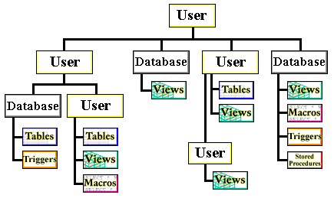
TERADATA STRUCTURES
Database structures
Users
Databases
Tables
Views
Macros
Triggers
Stored Procedures
User Defined Functions

Slide 12
Reference
Wikipedia
Tutorial Point
Slide Share

