Slide 1
Subject Name :Data Base Management System Presentation Title: IBM DB2
JEPPIAAR INSTITUTE OF TECHNOLOGY
“Self-Belief | Self Discipline | Self Respect”
Department of Computer Science and Engineering
Team Members:
Students Name Reg.No:
1.Deshmukh.P 210618104011
2.Aravindar.G.D 210618104004
3.Mohamad Ameer.A 210618104029
4.Ajith.S 210618104003
5.Sanjeev 210618104042
6.Pradeep 210618104033

Slide 2
Objective
To Design/ Analyze/ Evaluate
It is RDBMS
IBM DB2 was specially created to support features of Business Intelligence directly in the database. These abilities include data mining, ETL, OLAP and other advanced space features of analysis and statistics.
Much larger database files can be accommodated.

Slide 3
Database Architecture
Buffer Pool:
The bufferpool is portion of a main memory space which is allocated by the database manager. The purpose of bufferpools is to cache table and index data from disk. All databases have their own bufferpools.
Table Space:
A table space is a storage structure, it contains tables, indexes, large objects, and long data. It can be used to organize data in a database into logical storage group which is related with where data stored on a system.
Logs:
All databases have logs associated with them. These logs keep records of database changes. If a database needs to be restored to a point beyond the last full, offline backup, logs are required to roll the data forward to the point of failure.
Storage Groups:
A set of Storage paths to store database table or objects, is a storage group.

Slide 4
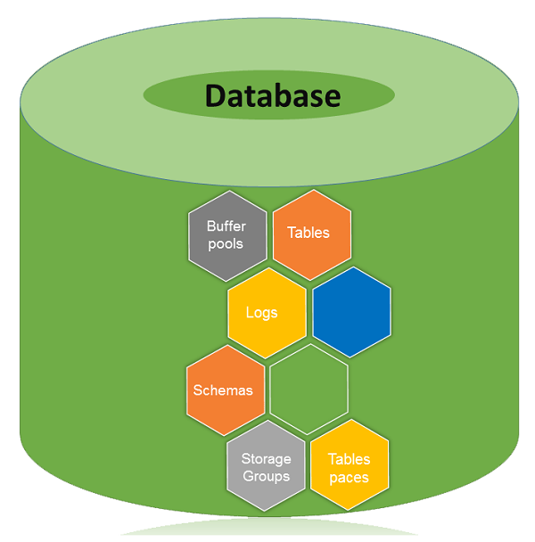

Slide 5
Security Database
Authentication:
Authentication is the process of confirming that a user logs in only in accordance with the rights to perform the activities he is authorized to perform. User authentication can be performed at operating system level or database level itself. By using authentication tools for biometrics such as retina and figure prints are in use to keep the database from hackers or malicious users.
Authorization:
You can access the DB2 Database and its functionality within the DB2 database system, which is managed by the DB2 Database manager. Authorization is a process managed by the DB2 Database manager. The manager obtains information about the current authenticated user, that indicates which database operation the user can perform or access.

Slide 6
Built-in-Data Types
Datetime
String
CHAR
VARCHAR
BOOLEAN
Binary integer
Decimal

Slide 7
DB2 with XML
PureXML feature allows you to store well-formed XML documents in columns of database tables. Those columns have XML database. Data is kept in its native hierarchical form by storing XML data in XML column. The stored XML data can be accessed and managed by DB2 database server functionality. The storage of XML data in its native hierarchical form enables efficient search, retrieval, and update of XML. To update a value in XML data, you need to use XQuery, SQL or combination of both.

Slide 8
Advantages of DB2
Error Processing:
The code returns
0 - successful execution
positive number -successful execution with one or more processing
negative number -unsuccessful execution with errors
Much larger database files can be accommodated.
Multiple Platform Support

Slide 9
Result & Discussion
DB2 is the lowest-scoring of the major brands of commercial RDBMS, but it's not dead yet. DB2 has an advantage that it has the best support for the impressive IBM POWER8 server architecture. I expect it to continue to hold a steady but small market share for 10-20 more years.

Slide 10
Applications
The Internet Bookshop
The Student Registrar
The Internet Airline
The Online Pharmacy

Slide 11
Reference
http://pages.cs.wisc.edu/~dbbook/openAccess/thirdEdition/DB2/db2applications.html
https://www.techwalla.com/articles/the-advantages-of-db2
https://www.tutorialspoint.com/db2/db2_introduction.htm
https://www.quora.com/Is-there-any-future-in-database-DB2

