Slide 1
Subject Name :Mobile Computing Presentation Title: Tele Communication
JEPPIAAR INSTITUTE OF TECHNOLOGY
“Self-Belief | Self Discipline | Self Respect”
Department of Computer Science and Engineering
Team Members:
Students Name Reg.No:
1. NAVEEN KUMAR T 210617104037
2. NISHANTH KUMAR 210617104038
3. MANJESH KUMAR 210617104029
4. JEFRI MALIN RAJ 210617104025
5. VIGNESH 210617104056
6. HEMANTH RAJ 210617104021

Slide 2
Objective
To Design/ Analyze/ Evaluate
Symbol Table
Use Of Symbol Table
Various Uses Of Compiler
Components Of Symbol Table
Symbol Table Operation
Issues In symbol Table

Slide 3
Telecommunication
Telecommunication occurs when the exchange of
information between communication participants includes
the use of technology.
It is transmitted through a transmission medium such as
over physical media, for example ,over electrical cable or via electromagnetic radiation.
The transmission of information that allows for
communication between people who are separated by
distance.

Slide 4
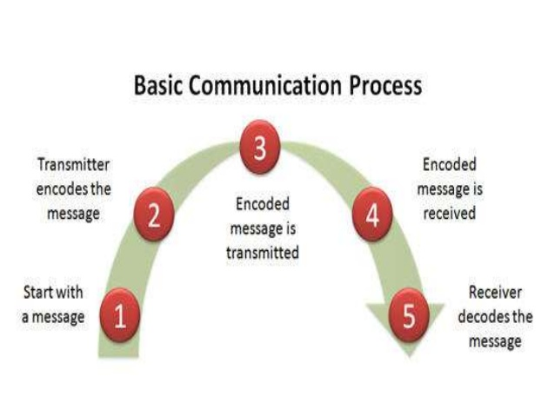
Block Diagram/ Work Flow/ Flow Chart

Slide 5
Three Units Of Telecommunication System
A Transmitter that takes information and convert it to a signal.
A Transmission medium,also called the “physical channel”that carries the signal.
A Reciever that takes the signal from the channel and convert it back
Into the usable information

Slide 6
Examples of Telecommunication System
Satellite Communication System
Mobile Cellular System
Radar and Sonar System
Microwave Radio System
TV and Radio Broadcast System

Slide 7
Technical Details

Slide 8
Technical Details

Slide 9
Technical Details

Slide 10
Result & Discussion

Slide 11
Future Scope
The transmission of information that allows for
communication between people who are separated by
distance.

Slide 12
Reference
Wikipedia
Tutorial Point
Slide Share

