Slide 1
Subject Name :Data Base Management System Presentation Title: Entity Relarionship Diagram
JEPPIAAR INSTITUTE OF TECHNOLOGY
“Self-Belief | Self Discipline | Self Respect”
Department of Computer Science and Engineering
Team Members:
Students Name Reg.No:
1. Adhwaitha Jasmith 210618104002
2. B. Sharu Bency 210618104047
3. R. Gowshika 210618104015
4. D. Teena 210618104054
5. Sharmila Roselin P.B 210618104046
6. A. Vijitta 210618104055

Slide 2
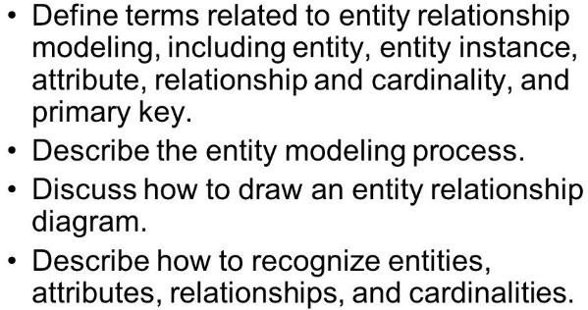
Objective
To Design/ Analyze/ Evaluate

Slide 3
Technical Details
What is an Entity Relationship Diagram (ERD)?
>ERD is a data modeling technique used in software engineering to produce a conceptual data model of an information system.
>So, ERDs illustrate the logical structure of databases.
>ERD development using a CASE tool
>Powerdesigner by SAP
>Data Modeler by Orcale

Slide 4
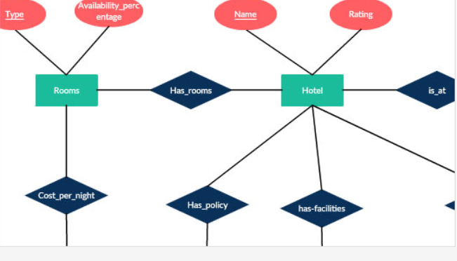
Block Diagram/ Work Flow/ Flow Chart

Slide 5
Technical Details
ERD
>The major activity of this phase is identifying entities, attributes, and their relationships to construct model using the Entity >Relationship Diagram.
>Entity → table
>Attribute → column
>Relationship → line

Slide 6
Technical Details
Uses of entity relationship diagrams
Database design: ER diagrams are used to model and design relational databases, in terms of logic and business rules (in a logical data model) and in terms of the specific technology to be implemented (in a physical data model.) In software engineering, an ER diagram is often an initial step in determining requirements for an information systems project. It’s also later used to model a particular database or databases. A relational database has an equivalent relational table and can potentially be expressed that way as needed.
Database troubleshooting: ER diagrams are used to analyze existing databases to find and resolve problems in logic or deployment. Drawing the diagram should reveal where it’s going wrong.

Slide 7
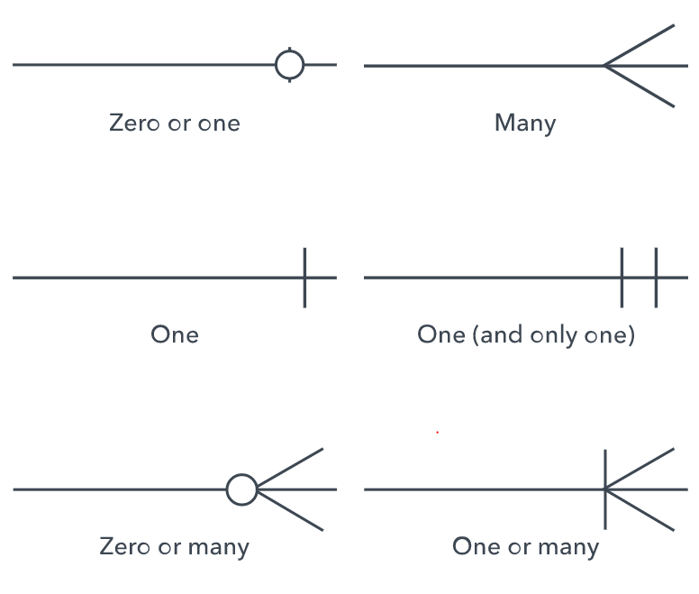
Technical Details

Slide 8
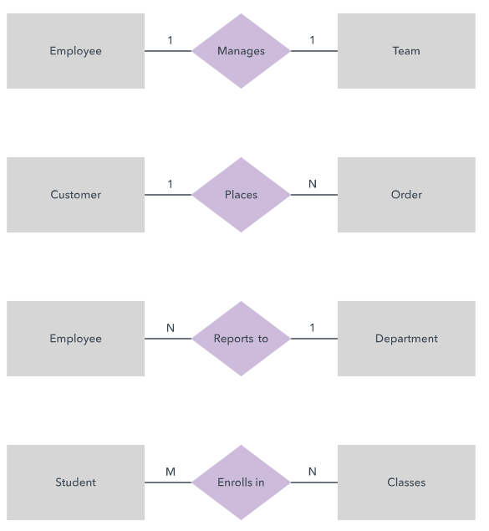
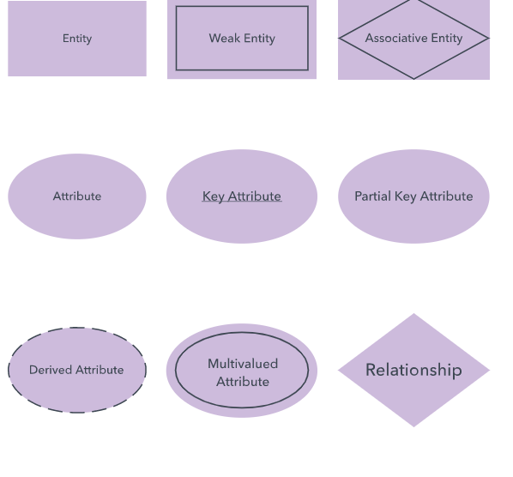
Technical Details
ERD symbols and notations
There are several notation systems, which are similar but vary in a few specifics.
Chen notation style

Slide 9
Technical Details
How to draw a basic ER diagram
Purpose and scope: Define the purpose and scope of what you’re analyzing or modeling.
Entities: Identify the entities that are involved. When you’re ready, start drawing them in rectangles (or your system’s choice of shape) and labeling them as nouns.
Relationships: Determine how the entities are all related. Draw lines between them to signify the relationships and label them. Some entities may not be related, and that’s fine. In different notation systems, the relationship could be labeled in a diamond, another rectangle or directly on top of the connecting line.
Attributes: Layer in more detail by adding key attributes of entities. Attributes are often shown as ovals.
Cardinality: Show whether the relationship is 1-1, 1-many or many-to-many.

Slide 10
Result & Discussion
After knowing all this informations and types of ER Diagram.
We can relate ER Diagram to relate real world objects.

Slide 11
Future Scope
Business information systems: The diagrams are used to design or analyze relational databases used in business processes. Any business process that uses fielded data involving entities, actions and interplay can potentially benefit from a relational database. It can streamline processes, uncover information more easily and improve results.
Business process re-engineering (BPR): ER diagrams help in analyzing databases used in business process re-engineering and in modeling a new database setup

Slide 12
Reference
1. A. Arora, M. Sinha, "Web Application Testing: A Review on Tools Techniques and State of Art", In International Journal of Scientific and Engineering Research, vol. 3, no. 2, February 2012, ISSN 2229-5518.
2. Linhua Ran et al., "Building Test Cases and Oracles to Automate Web Database Application Testing", Elsevier Information and Software Technology, vol. 51, no. 2, pp. 460-477, February 2009.
3. Blanco, R.V. Tuja J Seco, "Test Adequacy Evaluation for the User Database Interaction: A Specification based-Approach", In IEEE Sixth Conference on Software Testing Verification and Validation (ICST), 2013, ISBN 71-88.

